Slide 1
My Taxi Service
Project of Software Engineering II
Students:
Giuseppe Manzi (mat. 854470)
Alessandro Nicolini (mat. 858858)

Slide 2
Assignment 1: RASD
Requirement Analysis and Specification Document

Slide 3
WHAT IS?
ORIENTED TO
THE CLIENTS
ORIENTED TO THE PROGRAMMERS
It’s a document
UNAMBIGUOUS

Slide 4
SO…
ORIENTED TO
THE CLIENTS
ORIENTED TO THE PROGRAMMERS
Very detailed requirements
Few words and simply
Many schemas (UML)
UNAMBIGUOUS

Slide 5
The Leading Idea
We assumed not to have any pre-existent computerized information system
WE DECIDED TO PROJECT A SOFTWARE THAT DOES EXACTLY WHAT THE ACTUAL SYSTEM DOES

Slide 6
Allow taxi drivers to have a personal reserved area that helps them managing rides.
G2
G1
G3
GOALS
G4
G5

Slide 7
Allow guest users to request a taxi to reach him to a specific address as soon as possible.
G2
G1
G3
GOALS
G4
G5

Slide 8
Allow costumer to
have a personal reserved area. In addition to functionalities provided to guest users, a registered costumer can reserve a taxi for a specific time, check previous requests and reservations
and modify or delete them
G2
G1
GOALS
G4
G5

Slide 9
G2
G1
G3
GOALS
G4
G5
Guarantee a fair queue management

Slide 10
G2
G1
G3
GOALS
Manage the distribution of the taxis in each zone and notify taxi drivers the need to move from a zone to
another one.
G4
G5

Slide 11
REUIREMENTS
related to G2
3.2.2 - [G2] Allow guest users to request a taxi to reach him to a specific address as soon as possible.
[R2.1] Guest users can insert an address and a mobile phone number and ask for a taxi coming as soon as possible to there.
[R2.2] If enough taxis are available, the system assigns one of them to each incoming guest request.
[R2.3] The code of the taxi assigned to a guest request is sent by SMS to the number the costumer provided during the request.

Slide 12
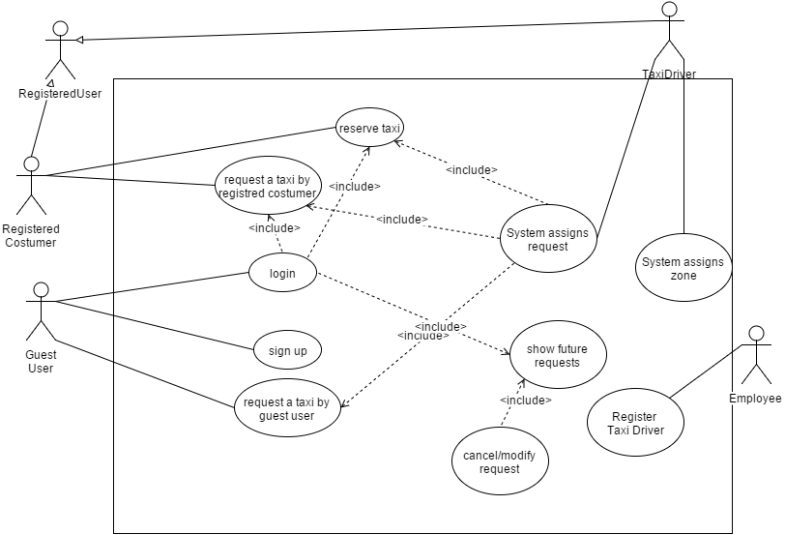
USE CASES

Slide 13
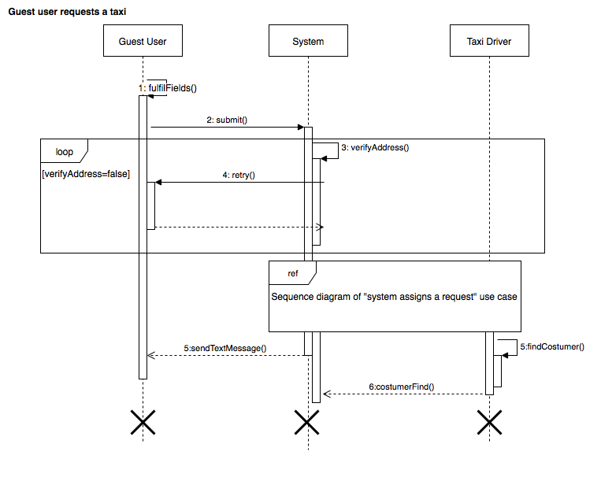

USE CASE

Slide 14
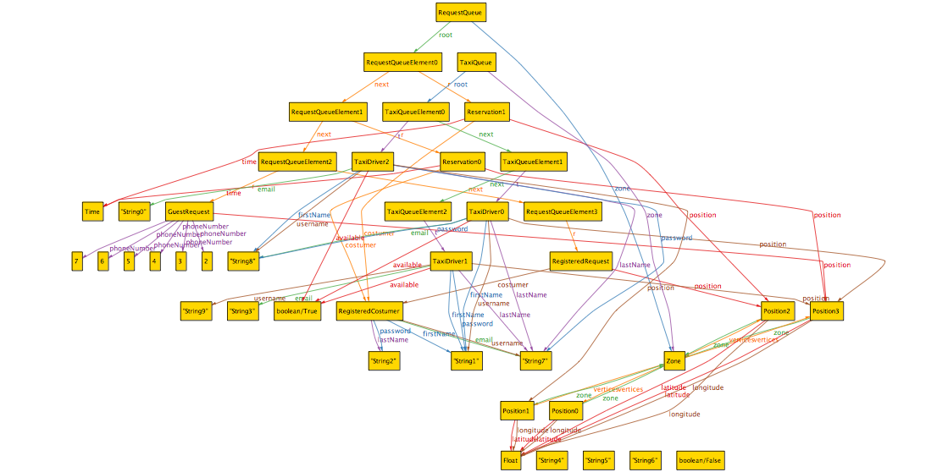
ALLOY STATE SPACE

Slide 15
Assignment 2: Design Document

Slide 16
2.1 Architectural Design
We will provide an objected oriented design, which is based on entities and on their interaction, consistent with the past object oriented analysis of the RASD.
We choose the 3-Tier style because of the need to separate the Client from the Server and to store and protect sensible data in a DBMS and for the high system performances that we want to reach.

Slide 17
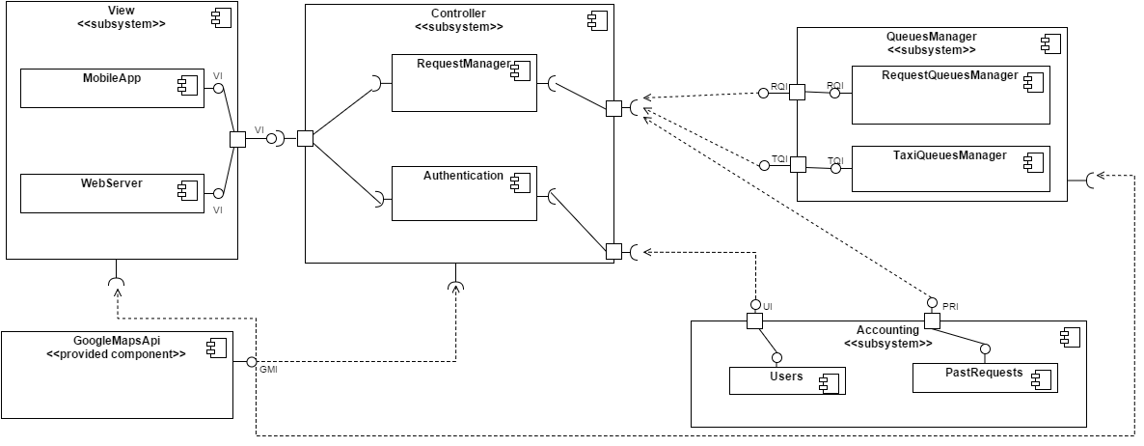
COMPONENT

Slide 18
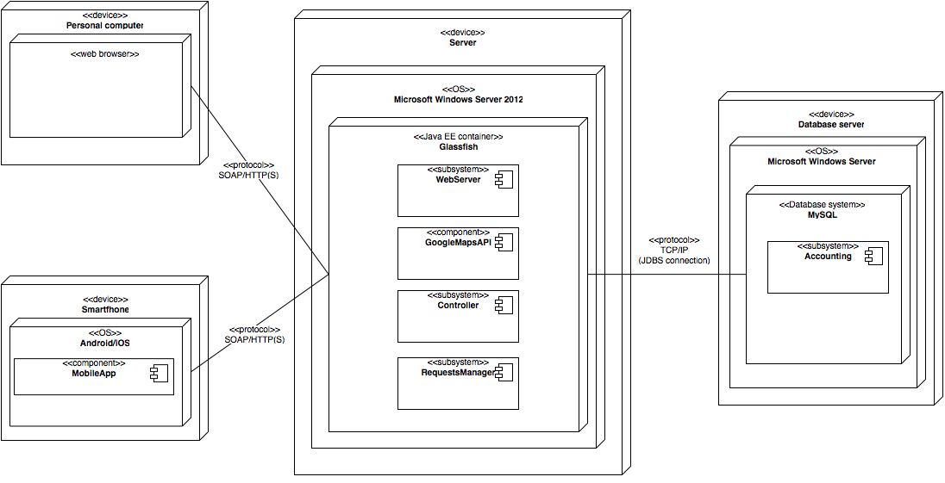
DEPLOYMENT

Slide 19
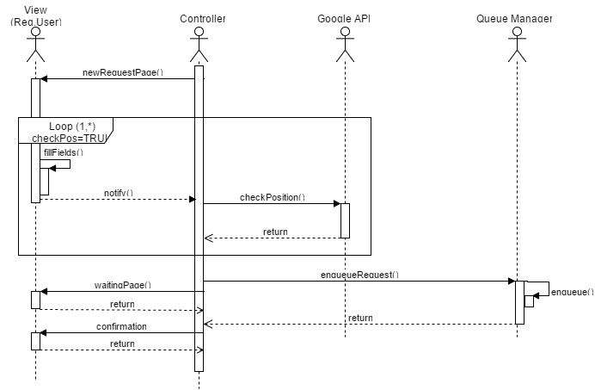
1) Add Request Sequence Diagram

Slide 20
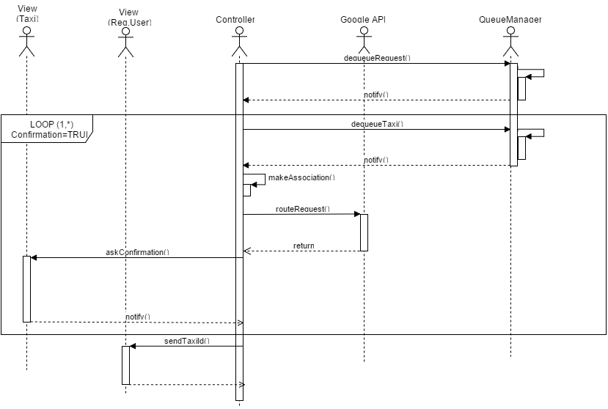
2) Request Association Sequence Diagram

Slide 21
Component Interfaces
RequestsQueueManagerInterface
void enqueueRequest(Request req)
void dequeueRequest()
TaxiQueueManagerInterface
void enqueueTaxi(TaxiDriver t)
void insertTaxiAsFirstItem(TaxiDriver t)
void dequeueTaxi()
UserAccountingInterface
void lookForAccount(String username)
void addAccount(String username, String password, String firstName, String lastName, String email)
RequestsQueueManagerInterface
void enqueueRequest(Request req)
void dequeueRequest()
TaxiQueueManagerInterface
void enqueueTaxi(TaxiDriver t)
void insertTaxiAsFirstItem(TaxiDriver t)
void dequeueTaxi()
UserAccountingInterface
void lookForAccount(String username)
void addAccount(String username, String password, String firstName, String lastName, String email)

Slide 22
Component Interfaces
PastRequestsInterface
void storeRequest(RegisteredRequest r)
void storeReservation(RegisteredReservation)
void lookForListOfRequests(String username)
ViewInterface
void createHome()
void createPersonalAreaHome(Class typeOfUser)
void createNewRequestPage()
void createNewReservationPage()
void createWaitingPage()
void createEnqueuedRequestPage()
void askConfirmation(String taxiDriverUsername, Position pos)
void notifyTaxiId(String id)

Slide 23
Selected architectural styles and patterns MI SA CHE è RIPETIZIONE
We selected the MVC architectural pattern. It implies he division of the whole application in three subsystems each one with a specific scope:
Model: it models the data used by the system and the state of the application. We split it into two parts, basing on the type of data:
Accounting: it stores data permanently and so it makes use of the database;
Requests Queue Manager: it stores data temporary.
Controller: it is the part of the application that contains the application logic.
View: it provides the functionalities that allows the users to interact with the application

